Slide 1


CONNECTTEL CUSTOMER CHURN PREDICTION
OLUWAKEMI SHOJUPE

Slide 2
INTRODUCTION
ConnectTel is a prominent telecommunications company known for its innovative and reliable connectivity solutions. With a global presence, it has become a trusted provider of voice, data, and Internet services. The company offers a wide range of telecommunications solutions, including mobile networks, broadband connections, and enterprise solutions, serving both individual and corporate customers. Committed to exceptional customer service and cutting-edge technology, ConnectTel ensures seamless communication experiences for millions of users worldwide. Through strategic partnerships and a customer-centric approach, the company continues to revolutionize the telecom industry, empowering individuals and businesses to thrive in the digital age.

Slide 3
Problem Overview:
ConnectTel Telecom Company is facing a critical challenge of customer churn.
Customer churn poses a significant threat to business sustainability and growth.
Current Issues:
Existing customer retention strategies lack precision and effectiveness.
Loss of valuable customers to competitors is a consequence of the ineffective strategies.
Objectives:
Accurately forecast customer churn using advanced analytics.
Implement targeted retention initiatives based on the predictions.
Benefits:
Proactive approach to reduce customer attrition.
Enhancement of customer loyalty.
Maintenance of a competitive edge in the dynamic telecommunications industry.

Slide 4
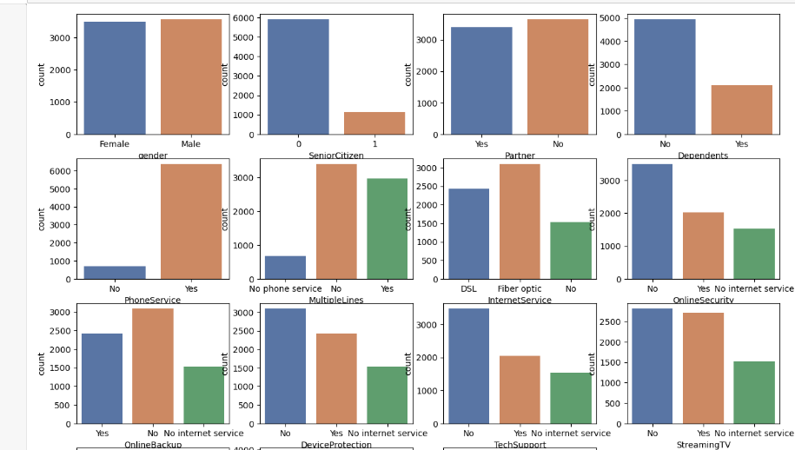
EXPLORATORY DATA ANALYSIS (EDA)
UNIVARIATE ANALYSIS
Univariate analysis was done to get the statistical analysis of a single feature at a time without considering its relationship with other features. This helps to provide a detailed understanding of the variables to uncover trends and patterns in the dataset,
A count was of each variables was done, and gender had a balanced count, customer with partners were lower than those without, customers with dependants were way higher than customers without dependants. More customers make use of Fiber optic internet services when compared to DSL and more of these customers are on month-to-month contract as against one or two years.

Slide 5
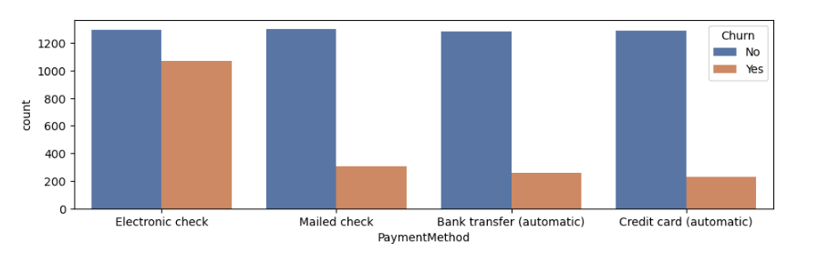
BIVARIATE ANALYSIS
Bivariate analysis involves the statistical analysis of two variables to determine if there is any relationship, correlation, or association between them. Bivariate analysis explores the connections between two variables to understand their mutual influence.
The relationship between the payment method and churn was carried out and it was discovered that in all payment methods, customers that has not cancelled the services had the highest count.

Slide 6
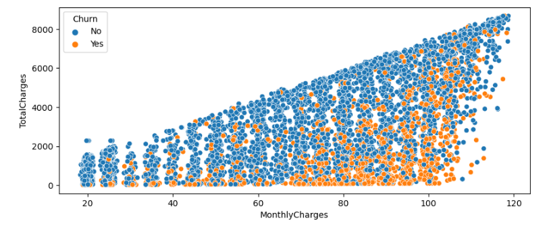
BIVARIATE ANALYSIS
The relationship between the total charges and monthly charges was done. The chart shows the increase in monthly charges has a significant increase in the total charges of customers that did not cancel the services.

Slide 7
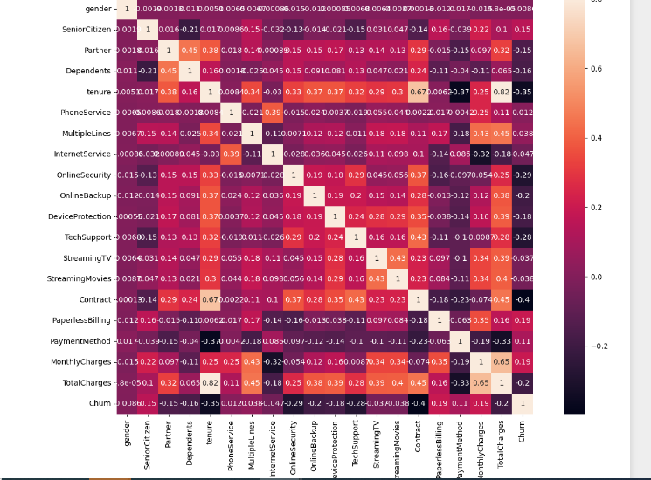
MULTIVARIATE ANALYSIS
Multivariate analysis involves the simultaneous examination and analysis of three or more variables to understand the relationships, patterns, and interactions among them.
Monthly charges and total charges are positively correlated to multiple lines, device protection and contract have negative correlation to churn, and all other variables are perfectively correlated to each other.

Slide 8
DATA PREPROCESSING
Label encoder was used to convert the categorical variables into numerical variables.
The target variable ‘Churn’ was inbalanced, hence, oversampling technique of resampling was deployed.
Some independent variables were removed, and the target variable was separated from the dataset.
MinMaxScaler was used in scaling the dataset.

Slide 9
MODEL BUILDING AND EVALUATION
The dataset was spilted into 70% Train and 30% Test.
The model used were;
Logistic Regression with an accuracy of 76%
DecisionTreeClassifier with an accuracy of 85%
RandomForestClassifier. with an accuracy of 89%
Accuracy is a commonly used metric to evaluate the overall performance of a classification model. A model with high Accuracy means that the proportion of correctly predicted instances (or observations) among all the instances is high.

Slide 10
MODEL EVALUATION
A confusion matrix is a table that is used to evaluate the performance of a classification model. It provides a detailed breakdown of the model's predictions, showing how many instances were correctly or incorrectly classified for each class. The confusion matrix is particularly useful when dealing with a classification problem where the goal is to assign instances to one of multiple classes.
True Positive (TP):
Instances that are actually positive (belong to the positive class) and are correctly predicted as positive by the model.
True Negative (TN):
Instances that are actually negative (belong to the negative class) and are correctly predicted as negative by the model.
False Positive (FP):
Instances that are actually negative but are incorrectly predicted as positive by the model. Also known as Type I error.
False Negative (FN):
Instances that are actually positive but are incorrectly predicted as negative by the model. Also known as Type II error.

Slide 11
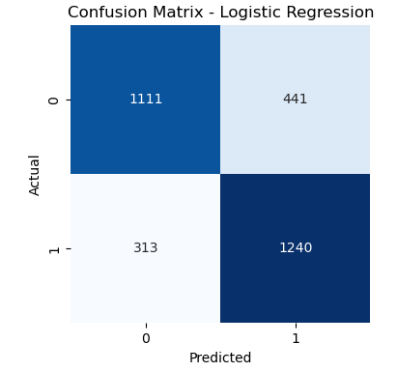
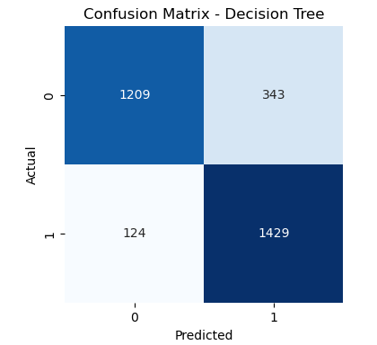
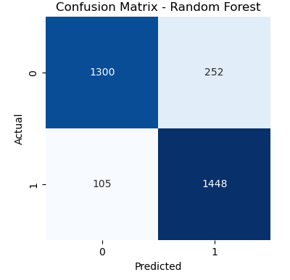
MODEL EVALUATION
Logistic Regression DecisionTreeClassifier RandomForestClassifier

Slide 12
MODEL EVALUATION
Logistic Regression DecisionTreeClassifier RandomForestClassifier
True Negative (TN): 1111
False Positive (FP): 441
False Negative (FN): 313
True Positive (TP): 1240
True Negative (TN): 1209
False Positive (FP): 343
False Negative (FN): 124
True Positive (TP): 1429
True Negative (TN): 1300
False Positive (FP): 252
False Negative (FN): 105
True Positive (TP): 1448

Slide 13
MODEL EVALUATION - CONCLUSION
With an 89% accuracy achieved by the Random Forest Classifier and the provided confusion matrix, we can draw several conclusions for the ConnectTel regarding predicting customer churn:
Overall Model Performance:
The Random Forest Classifier demonstrates a strong performance with an accuracy of 89%, indicating that it effectively predicts customer churn based on the available features.
Confusion Matrix Analysis:
The confusion matrix provides further insights into the model's performance. It shows that:
1300 instances of customers who did not churn were correctly classified as such (True Negatives).
1448 instances of customers who churned were correctly classified as such (True Positives).
252 instances were falsely predicted as churn (False Positives), potentially representing customers who were incorrectly flagged for churn.
105 instances of customers who churned were falsely predicted as not churning (False Negatives), indicating missed opportunities for intervention or retention strategies.
False Positive Rate:
The false positive rate 252 out of 1552 indicates the proportion of customers who were incorrectly classified as churning among those who actually did not churn. This could be an area of focus for optimizing the model to reduce false alarms.

Slide 14
MODEL EVALUATION - CONCLUSION
4. False Negative Rate:
The false negative rate 105 out of 1553 indicates the proportion of customers who were incorrectly classified as not churning among those who actually churned. Reducing this rate is crucial as it represents missed opportunities to retain potentially at-risk customers.
5. Actionable Insights:
Based on the model's predictions, ConnectTel can prioritize its retention efforts towards customers identified as likely to churn. This may include targeted marketing campaigns, personalized offers, or proactive customer service interventions.
6. Model Refinement:
While the model demonstrates strong performance, there is still room for improvement, particularly in reducing false positives and false negatives. This could involve feature engineering, adjusting model hyperparameters, or exploring alternative algorithms.
7. Continuous Monitoring:
Customer churn patterns may evolve over time, so it's essential to continuously monitor model performance and adapt strategies accordingly. Regular retraining of the model with updated data can help maintain its effectiveness in predicting churn.
In conclusion, the Random Forest Classifier provides a solid foundation for predicting customer churn in ConnectTel. By leveraging the insights from the model and the confusion matrix, ConnectTel can take proactive measures to retain customers and improve overall customer satisfaction and loyalty.

